Slide 1
Ionian Sea
It’s north of Africa, west of Greece, south of Italy, and east of Italy.
By Jesse Evers

Slide 2
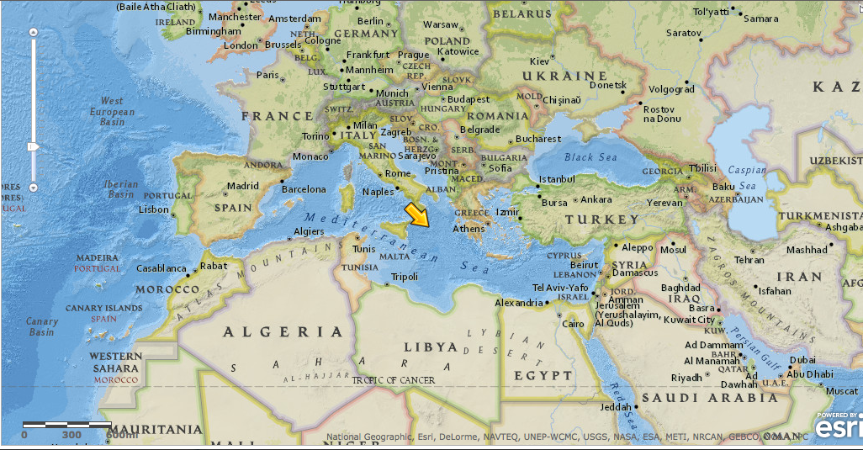
Ionian Sea

Slide 3
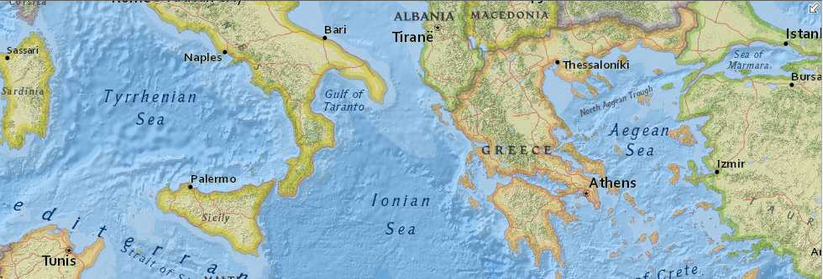
Ionian Sea

Slide 4

Ionian Sea
A Trans World Airlines flight going to New York from Tel Aviv crashed in the Ionian sea off Greece on September 8, 1974, killing all 88 persons on board. A message received in Paris right after the crash, reported to have come from a Palestinian youth group, claimed responsibility for the crash but this was subsequently denied by the Palestine Liberation Organization, considered an umbrella group covering all Palestinian guerrilla movements. The Athens coroner September 11 ruled out sabotage following post-mortems on the crash victims. Before the crash the pilot's radio reported problems with the right inboard engine which led officials to suggest that the rocking of the wings caused by storms in the area may have caused the engine to be ripped off the craft.

